Slide 1
Individual Presentation
APSIS Retreat
Diana Danilenko, 13.09.2023

Slide 2
Presentation Outline
Highlights
Behavioural interventions for efficient appliances adoption
LSR
Gender and justice in climate adaptation research
Project pitches
Project #1
Project #2
Project #3
Needs and requirements
Discussion

Slide 3


1.1 Highlights: A meta-analysis on the role of Behavioral Interventions & Incentives on Energy Efficiency Adoption
The project is at the stage of writing up / finalising the graphs.
MOTIVATION
The energy efficiency gap (underinvestment in energy efficiency despite the promised gains due to information failures, market failures, etc).
Importance of energy efficiency in mitigation pathways.
Mixed results from previous reviews, gap in reviews on appliance adoption.

Slide 4
1.1 Highlights: A meta-analysis on the role of Behavioral Interventions & Incentives on Energy Efficiency Adoption
METHODOLOGY
We designed a query that targeted appliance-specific interventions (labelling, information, monetary incentives and appliance standards), households and individuals as the population, and appliance purchase, WTP for energy efficiency, energy consumption as outcomes of interest. It was implemented on Web of Science, Scopus, JSTOR, and RePEc, and Google Scholar. This resulted in 30,902 records after removing duplicates and empty records.
We applied ML-assisted screening process with implementation of the stopping criteria for screening these documents at abstract level, which resulted in around 85% work savings and a recall of 0.9 achieved at p = 0.018.
We then manually screened 183 studies associated with appliance purchase at full text, and coded 60 of them, with 110 exclusions and 13 unretrievable texts. Coding was performed by 4 independent coders, with initial coding quality and agreement checks.
Studies identified through Web of Science
(n = 13554)
Studies identified through Scopus
(n = 21386)
Studies identified through RePEc
(n = 345)
Studies identified through JSTOR
(n = 1840)
Studies identified through Google Scholar
(n = 980)
Studies identified through existing reviews
(n = 32)
Search
Studies after removing duplicates and empty records
(n = 30902)
Empty records
(n = 1725)
Duplicates
(n = 5478)
Training set through manual reviews
Machine learning prioritized screening
Final set of predicted relevant studies
Studies after ML screening for which manual abstract screening was done
(n = 4788)
Studies screened at full text
(n = 182)
Irretrievable full texts
(not accessible, n = 9; not found, n = 4)
Screening
Studies excluded at full text screening, with reasons
(n = 110)
Excluded based on:
Other uncategorised dependent variables (n = 23)
Building renovation as dependent variable (n = 20)
Modelling market / individual response (n = 15)
Theoretical paper (n = 10)
No quantitative estimate (n = 10)
Not a relevant intervention (n = 7)
No uncertainty measures could be calculated (n = 7)
No specific appliance mentioned (n = 6)
Literature review (n = 3)
Socio-demographics as independent variable (n = 3)
Case study (n = 3)
Language (n = 1)
Pre-print of an included paper (n = 1)
Uncategorised appliance as dependent variable (n = 1)
Studies included after full text screening
(n = 59)
Synthesis

Slide 5





1.1 Highlights: A meta-analysis on the role of Behavioral Interventions & Incentives on Energy Efficiency Adoption
SUMMARY STATISTICS
291 effect sizes from 59 studies (about 5 effects per study) covering 27 different countries and approximately 1.1 million households;
information strategies vastly more represented compared to economic incentives;
more studies focusing on refrigerator, AC and lighting than any other appliances;
logit variations are the most common stat. techniques;
even number of control & treatment studies compared to quasi-experimental, less pre and post studies.

Slide 6
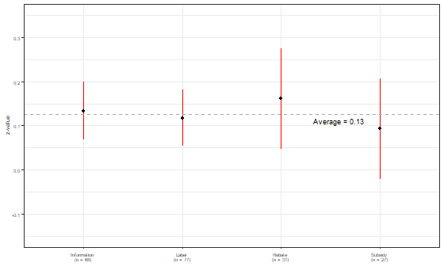
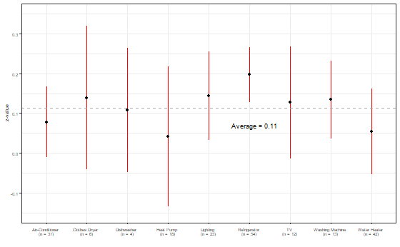
1.1 Highlights: A meta-analysis on the role of Behavioral Interventions & Incentives on Energy Efficiency Adoption
ESTIMATED AVERAGE EFFECTS FROM A REML MODEL
Notes:
There are a number of other groups in any given society which may exist in a political netherworld which marginalizes the group from significant representation and influence. Most obviously women are treated as a marginalized group despite the fact they make up a voting majority in many states. Other marginalized groups include: such as the young, the elderly, the impoverished and homeless, the disabled, and those of different sexual orientations.

Slide 7
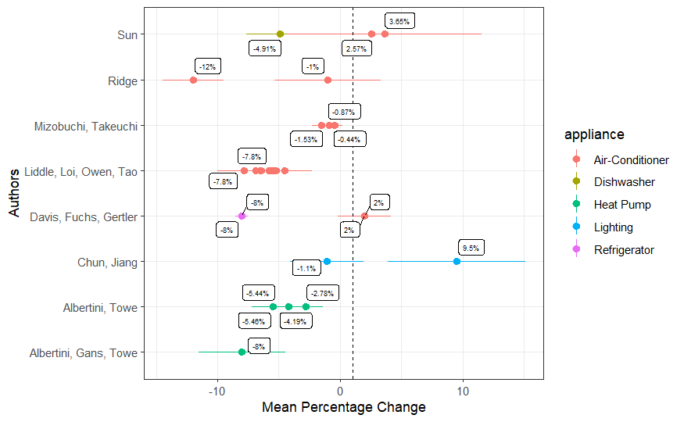
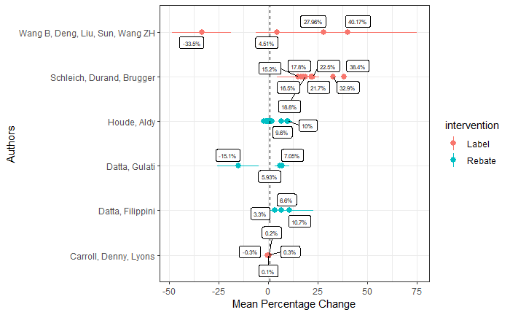
1.1 Highlights: A meta-analysis on the role of Behavioral Interventions & Incentives on Energy Efficiency Adoption
ENERGY USAGE
MARKET SHARE
Notes:
There are a number of other groups in any given society which may exist in a political netherworld which marginalizes the group from significant representation and influence. Most obviously women are treated as a marginalized group despite the fact they make up a voting majority in many states. Other marginalized groups include: such as the young, the elderly, the impoverished and homeless, the disabled, and those of different sexual orientations.

Slide 8



1.2 Highlights: LSR
We have collected studies for the baseline review, and are in the process of full-text coding.
We have prepared the query list to be moved to the new platform for future work.
The next steps include testing and adjusting the “living” part of the review.
Search publications
Define the search string.
Retrieve deduplicated records.*
Machine Learning
Prioritise document screening by applying a BERT classifier.*
Screen prioritised articles at abstract level.*
Stop when the 95% recall target is reached.
Data Retrieval / Analysis
Perform full-text coding and of the relevant studies*.
Harmonise effect sizes.*
Publish the data on an open repository.*
Implement an FE or an RE model.
8
* marked steps will be performed bi-weekly and the results made available at a public repository. Apart from that, a yearly summarised review will be produced and published.

Slide 9
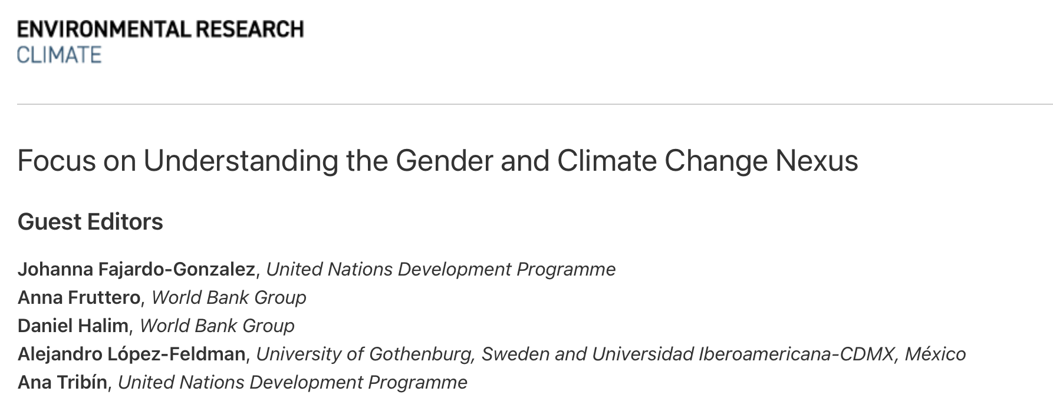
1.3 Highlights: Gender and justice in climate adaptation
We have re-evaluated the STM outputs and put all the data together, getting 13 topics that we classified as relevant to the climate justice framework.
I am still exploring the quantitative analysis – effect of control variables and presentation of results.
We are working on a webpage with interactive visualisations.
We’ll try to submit by end October?

Slide 10
2.1 Project Pitches: Equity in climate governance
climate governance - equity in adaptation and mitigation (particularly interesting the responsibility discourse), share of women
NLP
Qualitative systematic review
Qualitative primary study
10

Slide 11
2.2 Project Pitches: Ex-post evaluations prediction from abstracts
NLP
helpful for the systematic review work?
develop independently of a specific focus, and test on existing data
11

Slide 12
2.3 Project Pitches: Geographic sentiment analysis
sentiment analysis paired with geo-spatial data
NLP
GIS
on a topic (i.e. windfarms, CDR, mitigation)
i.e. do people who live closer to wind energy sites have different views on them?
data: sentiment analysis from twitter + locations, locations of wind farms, is twitter data even available?
scale: ?
geotagging of tweets - existing up to 2019 precise location tweets, new tweets coming from third-party apps - would there even be any for this RQ? averaging location box or geoparsing tweets for the rest of them
https://www.nature.com/articles/s41562-020-00949-x
12

Slide 13
3. Needs and requirements
As the most junior part of the team I appreciate any suggestions and guidance.
Understanding what topics are relevant for the audience / projects we are working on.
PhD
supervisor at MCC
supervisor at a university (Humboldt?)
funding (Heinrich-Böll-Stiftung / Hertie)
13

